Slide 1
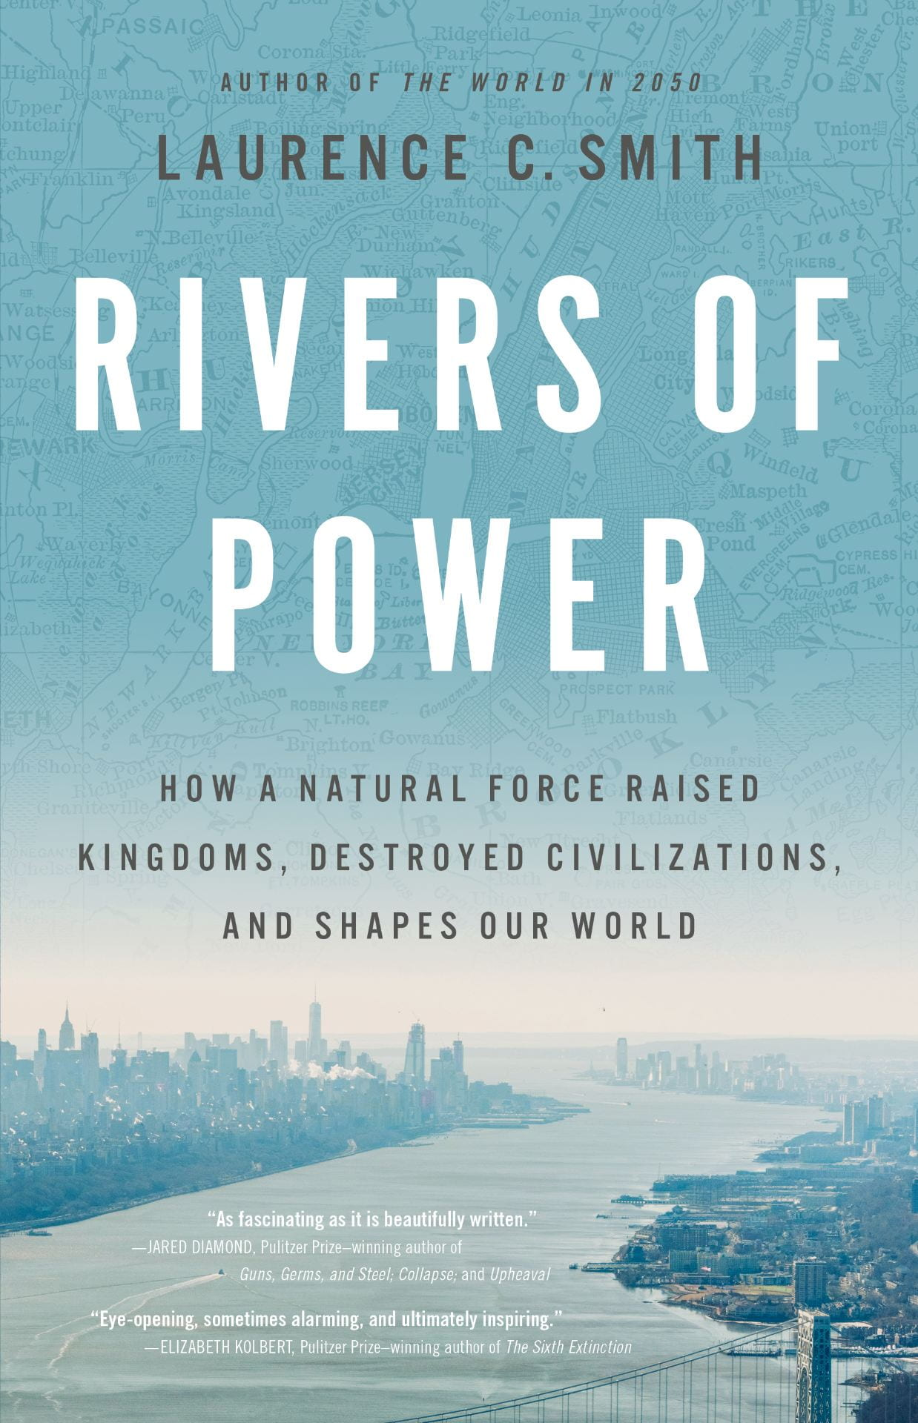
General-audience book: Rivers of Power
Smith, L. C. (2020) Rivers of Power: How a natural force raised kingdoms, destroyed civilizations, and shapes our world (Little, Brown & Co. (USA/Canada), Penguin Group (UK), international editions, ISBN 978-0-316-41200-01, https://riversofpower.org
A sweeping natural history of rivers and civilization and how rivers shape human welfare on Earth
Background: The dependence of civil society upon rivers has received little synthetic study. This book by Laurence C. Smith, a NASA-funded scientist (GSRP graduate Fellow, NASA New Investigator, NASA PI) and AGU Fellow explores the timeless yet surprisingly underappreciated relationship between rivers and civilization, from the Pharaohs to the space age.
Analysis: Historical accounts, literature reviews, personal interviews, field work and remote sensing
Findings: Rivers are important in many obvious ways (e.g. water supply, transportation, sanitation), but the depth of their influence on society is less obvious. Rivers define and transcend international borders, forcing cooperation between nations. Huge volumes of river water are used to produce energy, raw commodities, and food. Wars, politics, and demography are transformed by devastating floods. The territorial claims of nations, their cultural and economic ties to each other, and the migrations and histories of peoples trace back to rivers, river valleys, and the topographic divides they carve upon the world. As climate change, urbanization, and digital information alter humans’ relationship with nature, new advances in remote sensing, geospatial analysis, and modeling are rising to improve our stewardship of water resources globally.
Notes:
Citation: Smith, L. C. (2020) Rivers of Power: How a natural force raised kingdoms, destroyed civilizations, and shapes our world (Little, Brown & Co. (USA/Canada), Penguin Group (UK), ISBN 978-0-316-41200-01, https://riversofpower.org

