Slide 1
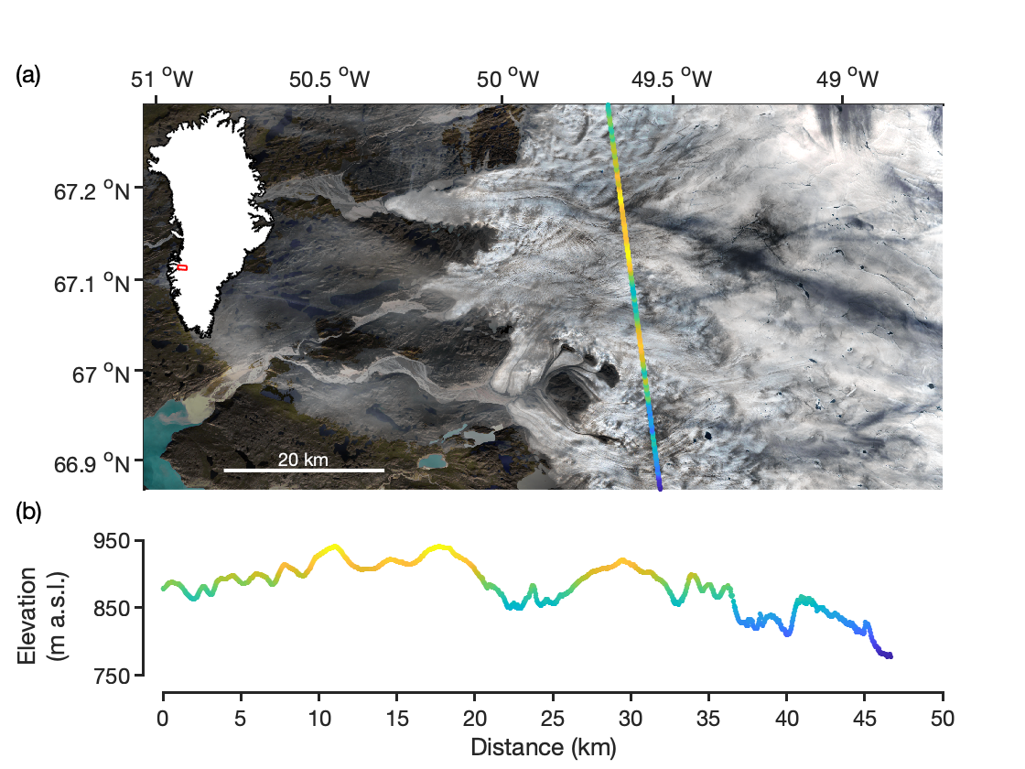
Satellite Remote Sensing of the Greenland Ice Sheet Ablation Zone: A Review
Matthew G. Cooper and Laurence C. Smith Remote Sens. 2019, 11(20), 2405; https://doi.org/10.3390/rs11202405
Background:
The Greenland Ice Sheet (GrIS) is the largest land ice contributor to global sea level rise, with recent mass loss acceleration driven by increased meltwater production in the ablation zone
Relative to Carl Benson’s pioneering studies in the 1950’s, climate model results indicate the ablation zone has expanded in size by ~50%
We review forty years of progress in satellite remote sensing the GrIS ablation zone with a focus on surface mass balance, covering progress in (1) radar altimetry, (2) laser (lidar) altimetry, (3) gravimetry, (4) multispectral optical imagery, and (5) microwave and thermal imagery
Fig 1. Sample of ICESat-2/ATLAS Level-3A data product Land Ice Height, Version 1 (ATL06) collected on 24 October 2018 in the southwestern GrIS ablation zone showing the rough crevassed ablation zone surface resolved by laser altimetry. Background image is Landsat 8 Operational Land Imager 30 m resolution true-color composite. ICESat-2 will provide high-accuracy surface elevation change measurements for continued mass balance estimates.
Significance:
Forty years of satellite remote sensing reveals an ablation zone expanded in size, its albedo and surface elevation lower in response to enhanced melting and ice discharge, and an ice sheet transition from steady state to negative mass balance. Satellite remote sensing provides a critical tool for continued monitoring of the GrIS mass balance.
Results:
Radar (CryoSat-2) and laser (ICESat and ATM) altimetry, together with gravimetry (GRACE), suggest the GrIS lost ~240 Gt yr⁻¹ during ~2008–2018 relative to a gain of ~50 Gt yr⁻¹ during 1972–1980^{1,2,3,4}
Albedo declined by ~0.1 per decade during the 2000–2013 period, driving increased melting from larger areas of exposed dark bare ice^{5,6,7,8}
Results (cont.)
Passive microwave and thermal imagery (e.g. SSMI/S, MODIS) provides ~40 years of melt extent and indicate the area of active surface melting has doubled since the early 1990s^{9,10,11,12}
Active microwave sensors provide new methods to map surface and subsurface meltwater, ice layers, snow accumulation, and diagnostic signatures of radar altimetry surface penetration depth^{13,14,15,16}
Notes:
Citation: Cooper, M.G.; Smith, L.C. Satellite Remote Sensing of the Greenland Ice Sheet Ablation Zone: A Review. Remote Sens. 2019, 11, 2405. https://doi.org/10.3390/rs11202405
Funding: This research was funded by NASA Cryosphere Program grant 80NSSC19K0942, managed by Dr. Thorsten Markus and Dr. Colene Haffke, and a graduate fellowship from the NASA Earth and Space Sciences Fellowship Program managed by Dr. Lin Chambers.
References
1. Mouginot, J.; Rignot, E.; Bjørk, A.A.; Broeke, M. van den; Millan, R.; Morlighem, M.; Noël, B.; Scheuchl, B.; Wood, M. Forty-six years of Greenland Ice Sheet mass balance from 1972 to 2018. PNAS 2019, 116, 9239–9244.
2. Csatho, B.M.; Schenk, A.F.; Veen, C.J. van der; Babonis, G.; Duncan, K.; Rezvanbehbahani, S.; Broeke, M.R. van den; Simonsen, S.B.; Nagarajan, S.; Angelen, J.H. van Laser altimetry reveals complex pattern of Greenland Ice Sheet dynamics. PNAS 2014, 111, 18478–18483.
3. Helm, V.; Humbert, A.; Miller, H. Elevation and elevation change of Greenland and Antarctica derived from CryoSat-2. The Cryosphere 2014, 8, 1539–1559.
4. Velicogna, I.; Sutterley, T.C.; Broeke, M.R. van den Regional acceleration in ice mass loss from Greenland and Antarctica using GRACE time-variable gravity data. Geophysical Research Letters 2014, 41, 8130–8137.
5. Stroeve, J.; Box, J.E.; Wang, Z.; Schaaf, C.; Barrett, A. Re-evaluation of MODIS MCD43 Greenland albedo accuracy and trends. Remote Sensing of Environment 2013, 138, 199–214.
6. Ryan, J.C.; Smith, L.C.; As, D. van; Cooley, S.W.; Cooper, M.G.; Pitcher, L.H.; Hubbard, A. Greenland Ice Sheet surface melt amplified by snowline migration and bare ice exposure. Science Advances 2019, 5, eaav3738.
7. Shimada, R.; Takeuchi, N.; Aoki, T. Inter-Annual and Geographical Variations in the Extent of Bare Ice and Dark Ice on the Greenland Ice Sheet Derived from MODIS Satellite Images. Front. Earth Sci. 2016, 4.
8. Box, J.E.; Fettweis, X.; Stroeve, J.C.; Tedesco, M.; Hall, D.K.; Steffen, K. Greenland ice sheet albedo feedback: thermodynamics and atmospheric drivers. The Cryosphere 2012, 6, 821–839.
9. Fettweis, X.; Tedesco, M.; van den Broeke, M.; Ettema, J. Melting trends over the Greenland ice sheet (1958–2009) from spaceborne microwave data and regional climate models. The Cryosphere 2011, 5, 359–375.
10. Nghiem, S.V.; Hall, D.K.; Mote, T.L.; Tedesco, M.; Albert, M.R.; Keegan, K.; Shuman, C.A.; DiGirolamo, N.E.; Neumann, G. The extreme melt across the Greenland ice sheet in 2012. Geophys. Res. Lett. 2012, 39, L20502.
11. Hall, D.K.; Comiso, J.C.; DiGirolamo, N.E.; Shuman, C.A.; Box, J.E.; Koenig, L.S. Variability in the surface temperature and melt extent of the Greenland ice sheet from MODIS. Geophysical Research Letters 2013, 40, 2114–2120.
12. Välisuo, I.; Vihma, T.; Pirazzini, R.; Schäfer, M. Interannual Variability of Atmospheric Conditions and Surface Melt in Greenland in 2000–2014. Journal of Geophysical Research: Atmospheres 2018, 123, 10,443-10,463.
13. Nghiem, S.V.; Steffen, K.; Neumann, G.; Huff, R. Mapping of ice layer extent and snow accumulation in the percolation zone of the Greenland ice sheet. Journal of Geophysical Research: Earth Surface 2005, 110, F02017.
14. Li, X.; Zhang, Y.; Liang, L. Snowmelt detection on the Greenland ice sheet using microwave scatterometer measurements. International Journal of Remote Sensing 2017, 38, 796–807.
15. Hicks, B.R.; Long, D.G. Inferring Greenland melt and refreeze severity from SeaWinds scatterometer data. International Journal of Remote Sensing 2011, 32, 8053–8080.
16. Rizzoli, P.; Martone, M.; Rott, H.; Moreira, A. Characterization of Snow Facies on the Greenland Ice Sheet Observed by TanDEM-X Interferometric SAR Data. Remote Sensing 2017, 9, 315.

